Slide 1
Low Dose Radiation in the Airline Industry
Low Dose Radiation in the Airline Industry
Edward T. Bramlitt, PhD
Edward T Bramlitt, PhD

Slide 2
NUWAX-1981

Slide 3
DC-SFO mSv exceeds
NUWAX-81 mSv
FAA 1978 Report
Pilots Flight Attendants
1.58 mSv 1.60 mSv

Slide 4
1985 Dose >1978 Dose:
Planes are flying higher
USA has international high-latitude flights
Flight attendants work >60 hours monthly
Solar radiation events happen
Crewmembers work while pregnant

Slide 5
FAA says (3/3/1986) it will:
Advise airlines to promote radiation safety
Advise crewmembers to limit dose by schedule choice
Inform crewmembers about radiation
Inform crewmembers of estimated flight doses

Slide 6
FAA Advisory Circular (AC) 1990 Extract
` AC (#) | Depart-Arrive (City Code) | Air (Hr) | Block (Hr) | (Rate (µSv Block⁻¹) | Dose (mSv An⁻¹)
13 | IAD-LAX | 4.7 | 5.0 | 24 | 4.9
17 | MSP-JFKT | 1.8 | 2.1 | 11 | 5.0
32 | ATH-JFK | 9.4 | 9.7 | 93 | 9.1
31 | LON-ORD | 7.8 | 8.3 | 62 | 7.1
15 | LAX-NRT | 11.7 | 12.0 | 62 | 4.9
4 | STL-TUL | 0.9 | 1.1 | 2.0 | 1.7
8 | DEN-MSP | 1.2 | 1.5 | 4.7 | 3.0
32 flights | Average | 5.1 | 5.5 | 33.2 | 4.7 ± 2.2
27 flights | Average | 5.8 |  |  | 3.8 ± 1.4

Slide 7
Dying to Fly, FAA 1990 AC
Cancer deaths/1,000 = AD×6.3×Y/100
Annual Dose AD = 5.0 mSv
Years Y = 20
Activity | Deaths | Deathse
Flying | 6
Not Flying | 220 Males | 188 Females

Slide 8
Sources Exposing Flights
Name | Year 1 | Frequency | Comment
GCR | 1912 | Continuous | By NM since 1945
 | 1945 | 71 GLE | 35 GLE since 1976
SPE | 1976 | 270 | By GOES
SNE | 1980 | ~20 | By various satellites/SNT
SGE | 2011 | ~0.7SPE | By Fermi LAT
TGF | 1994 | 1,100 day⁻¹ | By Fermi GBM

Slide 9
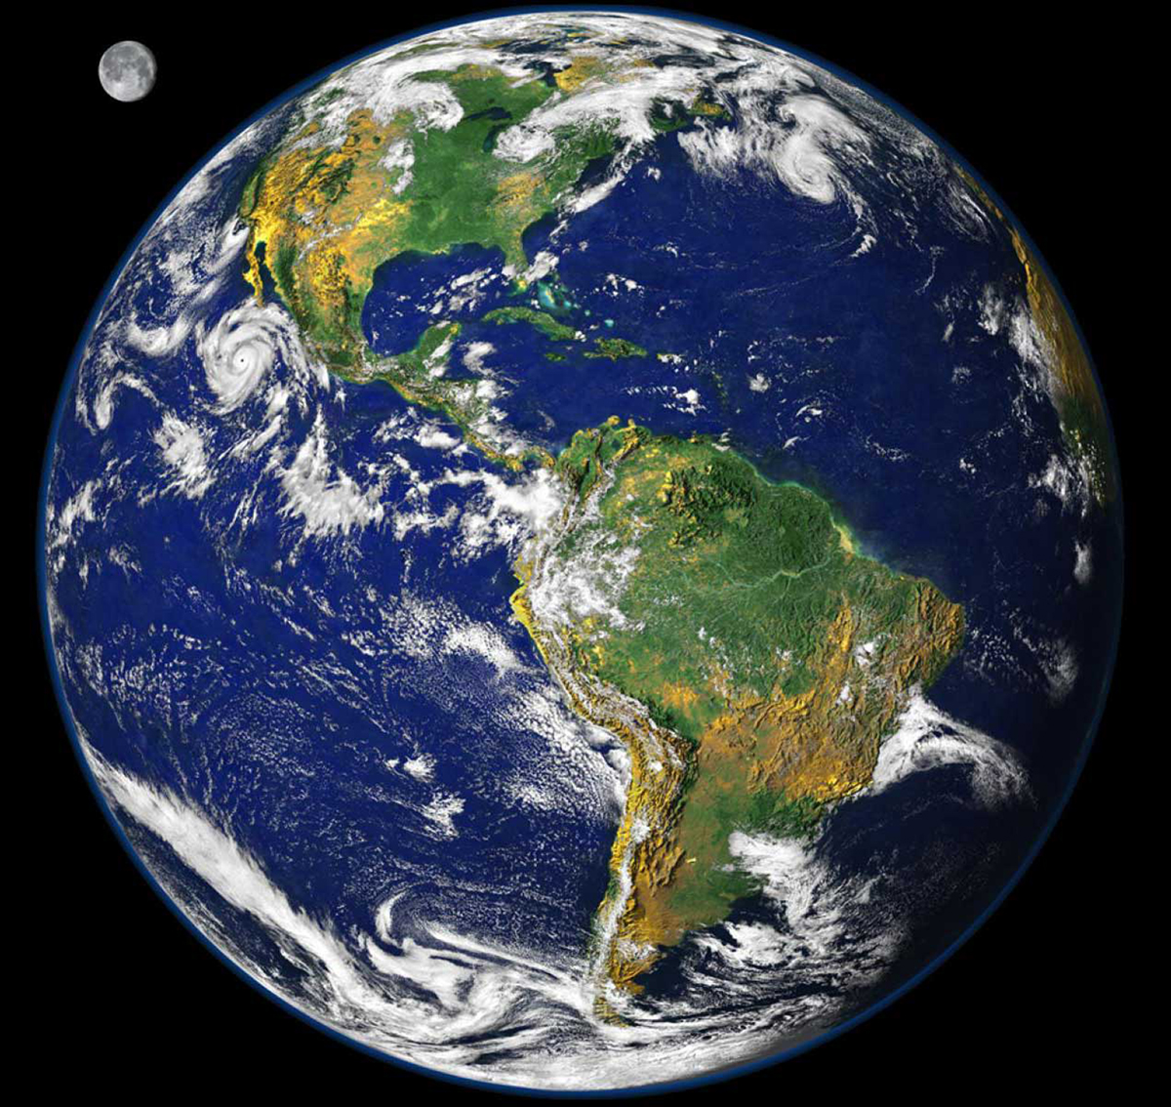
Radiation and Latitude
Protons
Neutrons and Gamma Rays
Subsolar Point Longitude
SP = (720 - EoT - UT)/4
Protons

Slide 10
Radiation and Altitude (hkft)/Pressure (hPa)
FL | 15° | -20° | -40° | -56.7° | -60°
400 | 188 | 141 | 115(° | 93 | 88.7
390 | 197 | 150 | 123 | 100 | 95.5
380 | 206 | 159 | 130 | 107 | 103
370 | 217 | 168 | 139 | 115 | 111
360 | 227 | 178 | 149 | 124 | 119

Slide 11
Radiation and Planes: Long-Haul; Polar
NPR >78°N

Slide 12
Radiation Dose by Calculation
Flux
Exposure Time
Fluence-to-Dose Factor

Slide 13
13 May 2013 SGE Over USA

Slide 14
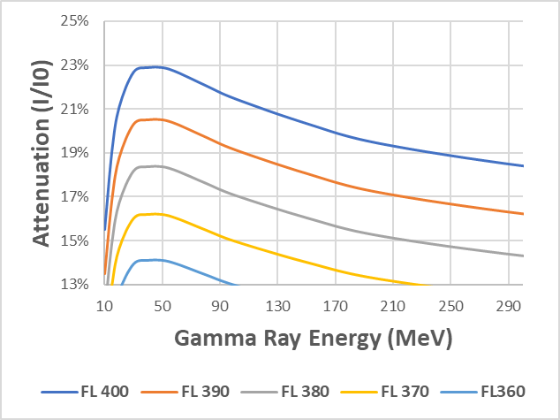
13 May 2013 SGE Attenuation

Slide 15
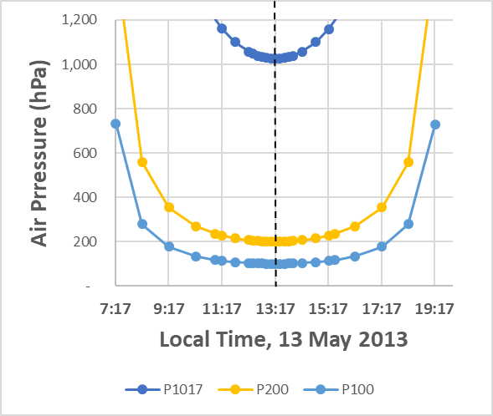
Air Pressure Over Miami, FL

Slide 16
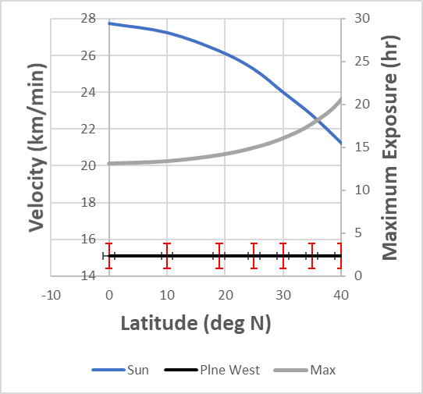
Velocities West and SGE Exposure
T_{w} = V_{s}R/(V_{s}–V_{p})
T_{E} = V_{s}R/(V_{s}+V_{p}
R = 6 Hours

Slide 17
SPE at GOES, 8 Jan 2014
Chan (#) | NOAA (MeV | NASA (MeV) | FWHM (Hr) | Peak (m/d/y) | Peak (h:m) | NO-Pace (min AU⁻¹) | NA-Pace (min AU⁻¹ | MaxFlux (pfu)
P3 | 11.6 | 11.6 | 25 | 1/8/14 | 21:15 | 53.4 | 53.4 | 120
P4 | 30.6 | 24.5 | 26 | 1/8/14 | 16:00 | 33.4 | 37.1 | 35
P5 | 63.1 | 56.6 | 8 | 1/8/14 | 3:00 | 23.8 | 25.0 | 2.5
P6 | 165 | 115 | 11 | 1/8/14 | 2:25 | 15.8 | 18.3 | 0.045
P7 | 433 | 287 | 8.3 | 1/8/14 | 1:15 | 11.4 | 12.9 | 0.01

Slide 18
2018 Dose >1985 Dose:
More sources than GCR
Long-haul flights
Polar-route flights
More planes cruise with less air shielding
More air travelers get dose
More crewmember exposures >40 years

Slide 19
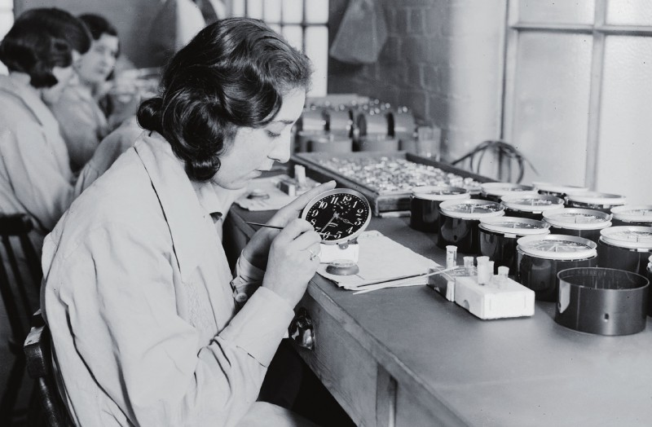
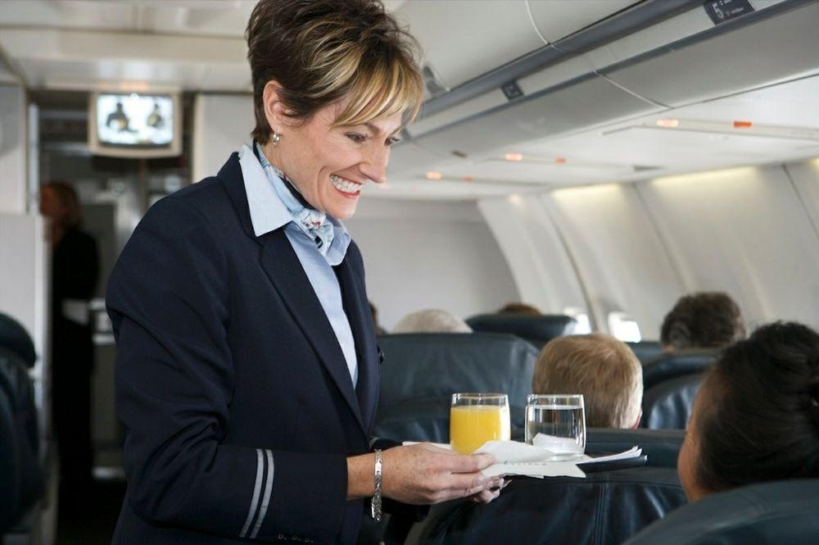
Risk Models and the Real World
Ra Dial Painter
Flight Attendant
Bad Model | Uncertain Model
Died | TBD

Slide 20
The End?

